Slide 1
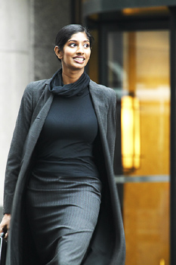
3-1 FORM AND BASIC MEANING OF THE SIMPLE PRESENT TENSE
She walks in the morning.

Slide 2
positive
I
play
basketball.
You
play
basketball.
He
plays
basketball.
She
plays
basketball.
It
plays
basketball.
We
play
basketball.
You
play
basketball.
They
play
basketball.

Slide 3
negative
I
don’t
wash
the car.
You
don’t
wash
the car.
He
doesn’t
wash
the car.
She
doesn’t
wash
the car.
It
doesn’t
wash
the car.
We
don’t
wash
the car.
You
don’t
wash
the car.
They
don’t
wash
the car.

Slide 4

(+)
You
play
soccer
in the afternoon
(-)
don’t

Slide 5
3-1 FORM AND BASIC MEANING OF THE SIMPLE PRESENT TENSE
SINGULAR PLURAL
1st PERSON
I walk
we walk
2nd PERSON
you walk
you walk
3rd PERSON
she walks
he walks
it walks
they walk

Slide 6
3-1 Let’s Practice
watch
We _____ TV in the afternoon.
watch
watches

Slide 7
3-1 Let’s Practice
watches
He _______ television in the morning
watch
watches

Slide 8
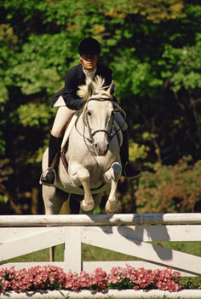
3-1 Let’s Practice
My friend doesn´t ____ her horse.
like
likes
like

Slide 9
3-1 Let’s Practice
eat
We ____ lunch at 12:00.
eat
eats

Slide 10
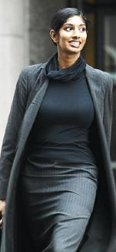
3-1 Let’s Practice
Jara _____ a walk in the morning.
takes
take
takes

Slide 11
3-1 Let’s Practice
eat
We don´t ____ lunch at 12:00.
eat
eats

Slide 12
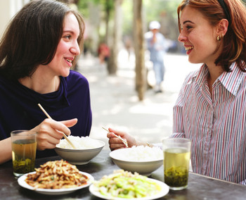
3-2 USING FREQUENCY ADVERBS: ALWAYS, USUALLY, OFTEN, SOMETIMES, SELDOM, RARELY, NEVER
They eat Chinese food for lunch.

Slide 13
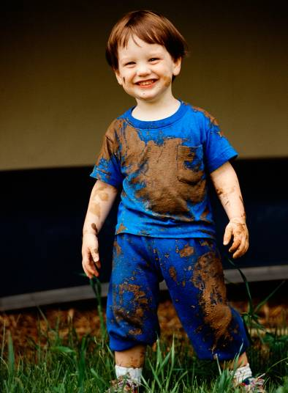
3-4 USING FREQUENCY ADVERBS WITH BE
Jeff is dirty.
He isn´t clean.

Slide 14
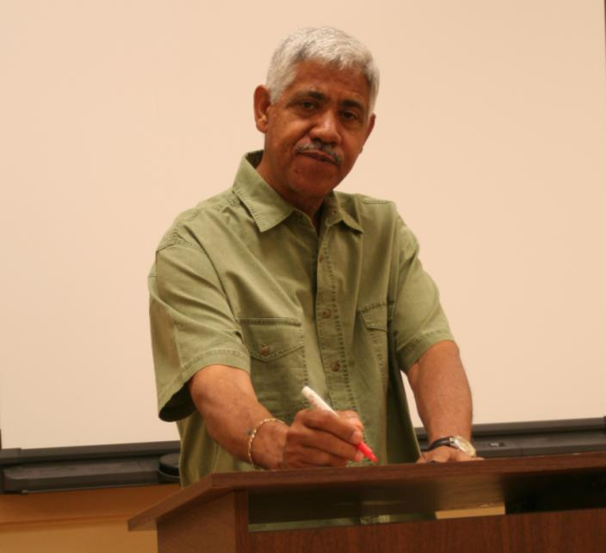
3-5 SPELLING AND PRONUNCIATION OF FINAL -ES
Gerardo teaches math.

Slide 15
3-5 SPELLING AND PRONUNCIATION OF FINAL -ES
SPELLING
-sh
(a) push
pushes
-ch
(b) teach
teaches
-ss
(c) kiss
kisses
-x
(d) fix
fixes
endings
add -es

Slide 16
3-5 Let’s Practice
watch
Seung ______ his TV program.
watches

Slide 17
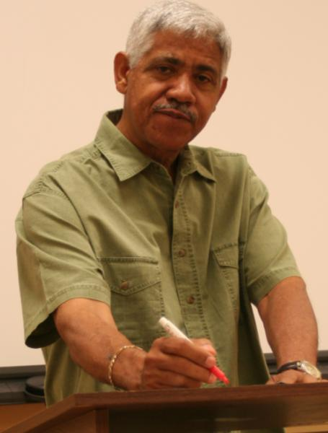
3-5 Let’s Practice
teach
Gerardo _______ math at PUCP
teaches

Slide 18
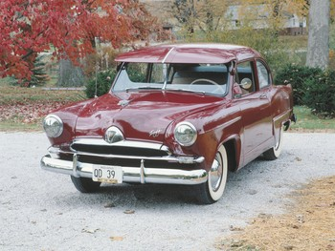
3-5 Let’s Practice
wash
washes
Viktor always _______ his car.

Slide 19
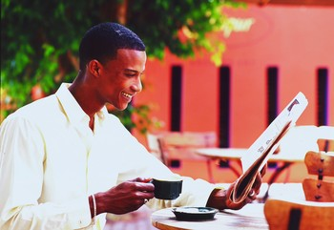
3-5 Let’s Practice
mix
Ade ______ sugar
in his coffee.
mixes

Slide 20
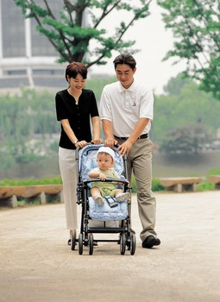
3-6 ADDING FINAL -S / -ES TO WORDS THAT END IN -Y
The baby cries a lot.

Slide 21
3-6 ADDING FINAL -S / -ES TO WORDS THAT END IN -Y
(a) cry
cries
consonant + -y
change y to i,
add -es
fly
flies
(b) pay
pays
vowel + -y
add -s
enjoy
enjoys

Slide 22
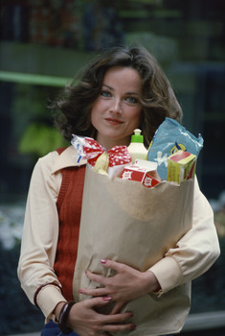
3-6 Let’s Practice
buy
Gazi _________ a lot of food.
buys

Slide 23
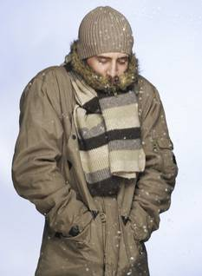
3-7 IRREGULAR SINGULAR VERBS: HAS, DOES, GOES
The man has a brown coat.

Slide 24
3-7 IRREGULAR SINGULAR VERBS: HAS, DOES, GOES
Irregular forms:
she
he
it
(a) I have a hat.
+
has
(b) She has a hat.
have
has
she
he
it
(c) I do exercises.
(d) He does exercises.
does
+
do
does
she
he
it
(e) We go to the gym.
(f) He goes to the gym.
+
goes
go
goes

Slide 25
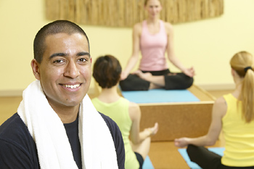
3-7 Let’s Practice
do does
George ____ yoga every day.
does

Slide 26
3-7 Let’s Practice
go goes
Zhou-li ______ for a walk on Sunday.
goes

Slide 27
3-7 Let’s Practice
have has
She always ____ homework.
has

Slide 28
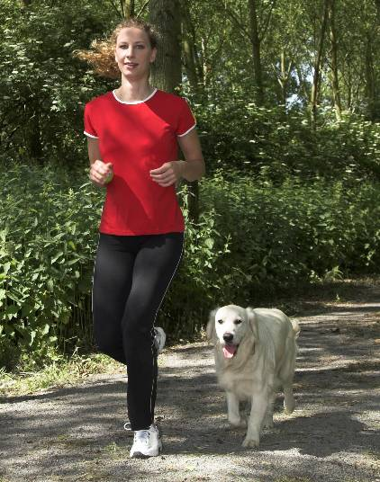
3-8 SPELLING AND PRONUNCIATION OF FINAL -S / -ES
She runs six miles every day.

Slide 29
3-8 SPELLING AND PRONUNCIATION OF FINAL -S / -ES
SPELLING
(a) run
runs
rain
rains
scrub
scrubs
love
loves
3rd person singular add -s

Slide 30
3-8 SPELLING AND PRONUNCIATION OF FINAL -S I -ES
SPELLING
(b) sink
sinks
meet
meets
fight
fights
cough
coughs
3rd person singular add -s

Slide 31
3-8 SPELLING AND PRONUNCIATION OF FINAL -S I -ES
SPELLING
(c) push
pushes
watch
watches
miss
misses
tax
taxes
-sh, -ch, -ss, -x
3rd person singular add -es

Slide 32
3-8 SPELLING AND PRONUNCIATION OF FINAL -S I -ES
SPELLING
(d) dry
dries
study
studies
consonant + -y
3rd person singular
change y to i, add -es

Slide 33
3-8 SPELLING AND PRONUNCIATION OF FINAL -S I -ES
SPELLING
(e) pay
pays
buy
buys
vowel + -y
3rd person singular
add -s

Slide 34
3-8 SPELLING AND PRONUNCIATION OF FINAL -S I -ES
SPELLING
(f) have
has
go
goes
do
does
3rd person singular forms
irregular

Slide 35
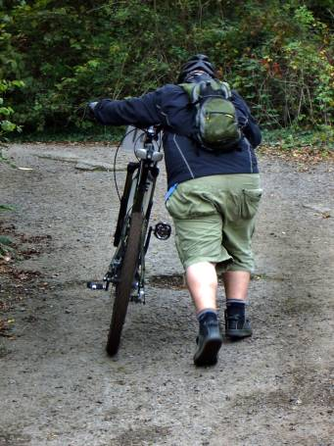
3-8 Let’s Practice
push
Mark ______ his
bike up the hill
every afternoon.
pushes

Slide 36
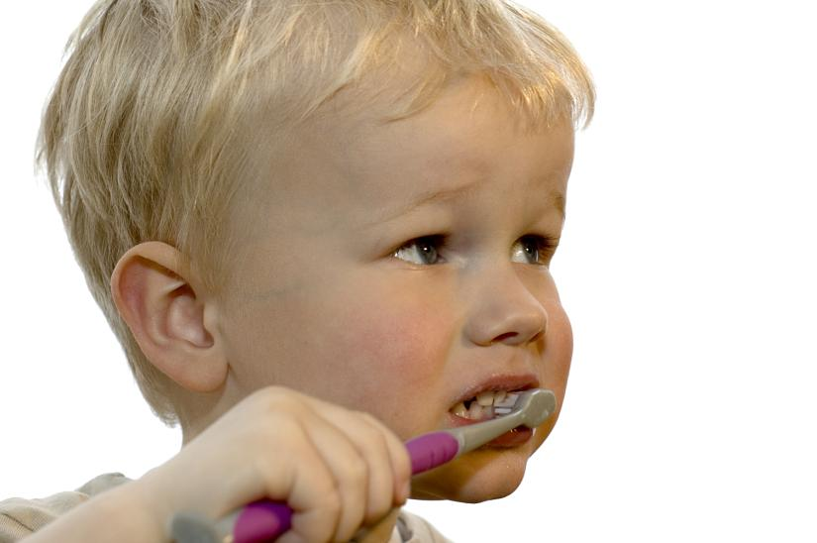
3-8 Let’s Practice
The child _______ his
teeth every morning.
brushes
brush

Slide 37
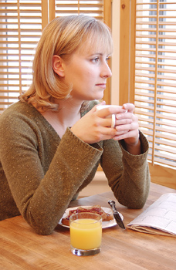
3-8 Let’s Practice
dream
Brenda often ______
about her old home.
dreams

Slide 38
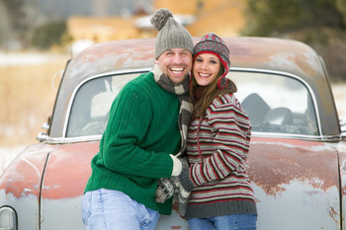
3-9 THE SIMPLE PRESENT: NEGATIVE
They do not wash their car.

Slide 39
3-9 THE SIMPLE PRESENT: NEGATIVE
They
You
We
I
(a) do not drink milk.
I
We
You
They
NEGATIVE:
+ do not + main verb
He
She
It
(b) does not drink milk.
She
He
It
+ does not + main verb

Slide 40
3-9 THE SIMPLE PRESENT: NEGATIVE
I do not drink milk.
She does not drink milk.
do and does = helping verbs
?
She does not drinks milk.
3rd person singular no -s on main verb

Slide 41
3-9 THE SIMPLE PRESENT: NEGATIVE
(c) I don’t drink milk.
They don’t go to the lake.
(d) He doesn’t drink milk.
Jack doesn’t like dogs.
CONTRACTIONS:
do not = don’t
does not = doesn’t

Slide 42
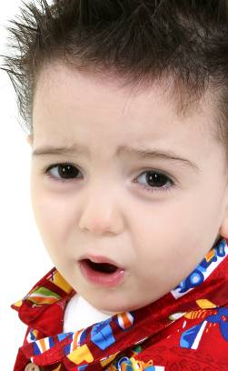
3-9 Let’s Practice
smile not
This child ___________.
doesn’t smile
(use the contraction)

Slide 43
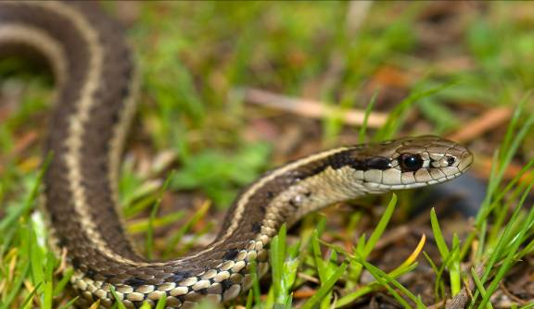
3-9 Let’s Practice
We ________ snakes.
don’t like
like not
(use the contraction)

Slide 44
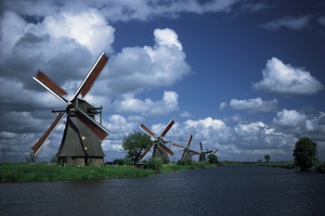
3-9 Let’s Practice
Magda ___________ Dutch.
doesn’t speak
(use the contraction)
speak
not

Slide 45
3-9 Let’s Practice
don’t
doesn’t
eat
jump
run
speak
don’t
eat
Sometimes I ____ ____ my lunch.
My friend _____ it.
eats

Slide 46
3-9 Let’s Practice
don’t
doesn’t
sit
need
like
run
doesn’t
run
She ______ ____ fast at the gym.
She gets tired.

Slide 47
3-9 Let’s Practice
don’t
doesn’t
feed
jump
need
eat
They are good cooks.
need
don’t
They ____ ____ help.

